Slide 1


The Fine Tuners
21.11.2023
Presented by Erjon Buka

Slide 2

Table of Content
Review the goals
01
02
Pull the tweets
Analyze the tweets
03
04
Get Suggestions
Conceptual Dashboard
05

Slide 3
Review Goals
Aligning Project and Business Goals
Identifying Common Issues
Trend Analysis
Predictive Maintenance
Resource Allocation
Real Time Monitoring
Notes:
I would like to go back to business understanding

Slide 4
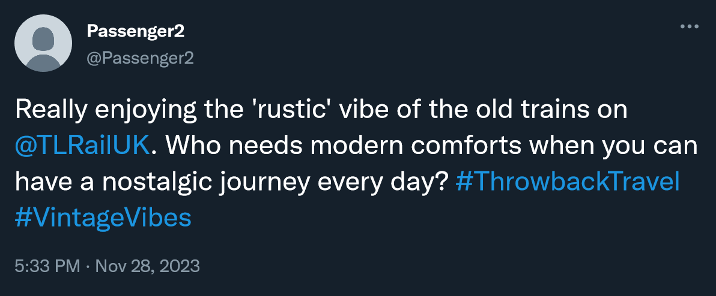
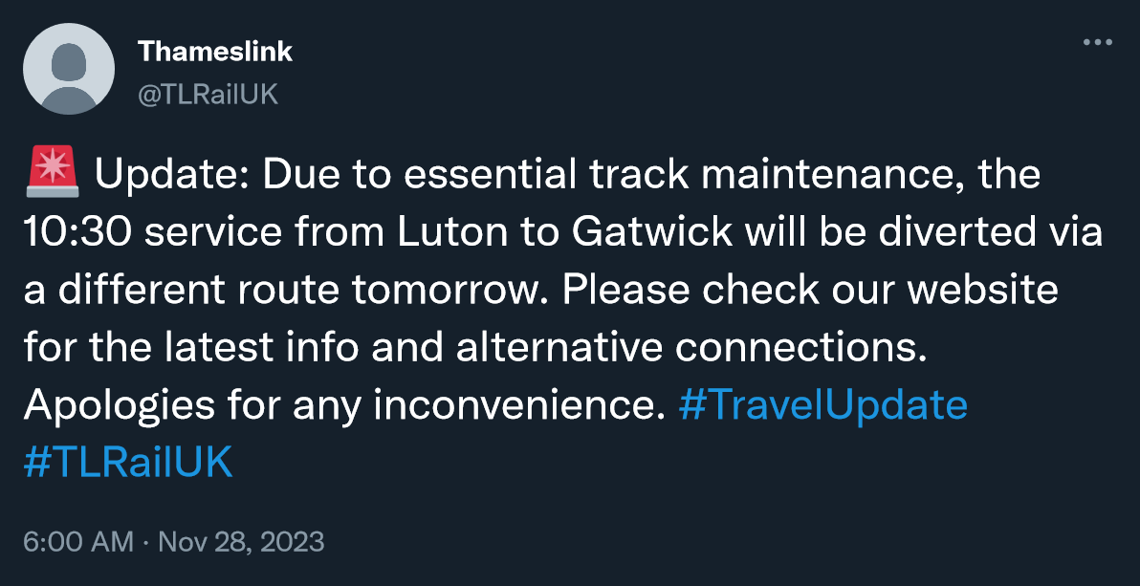
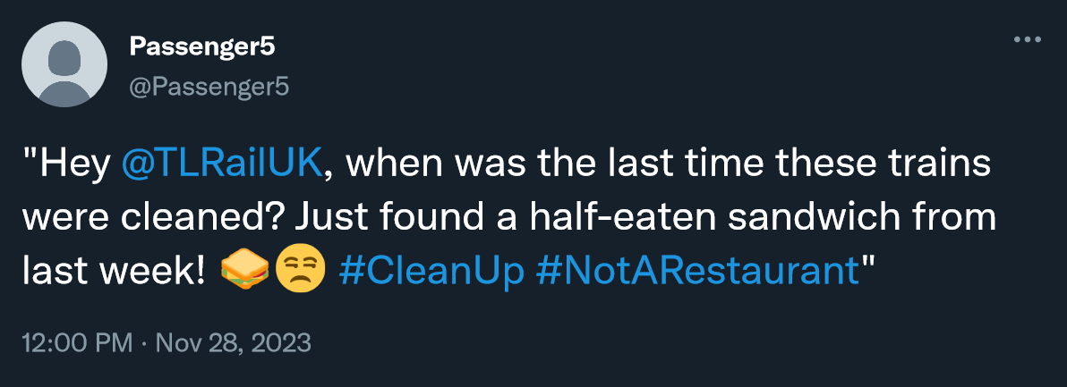
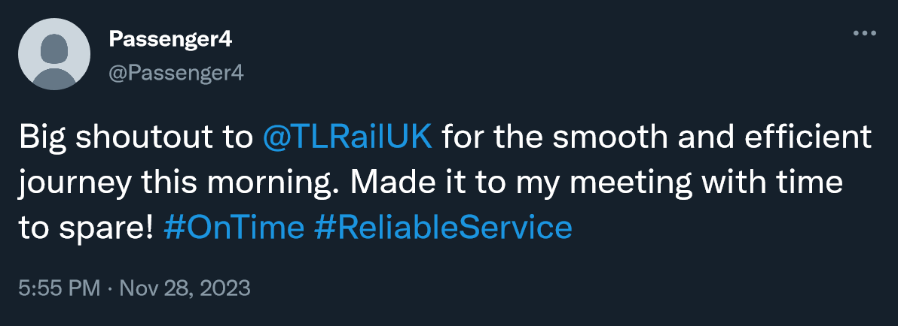
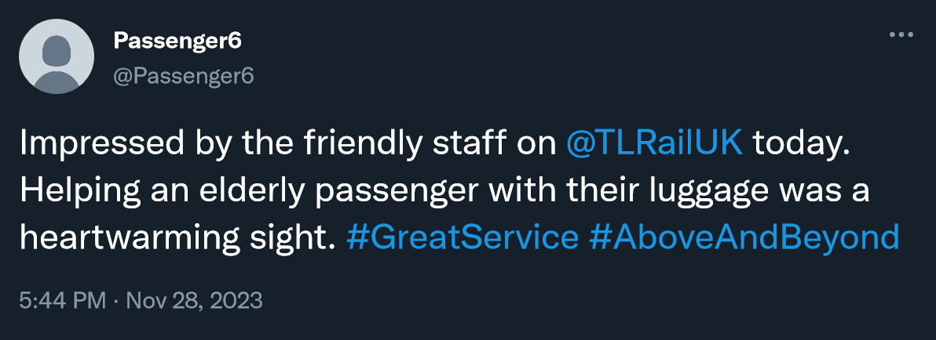
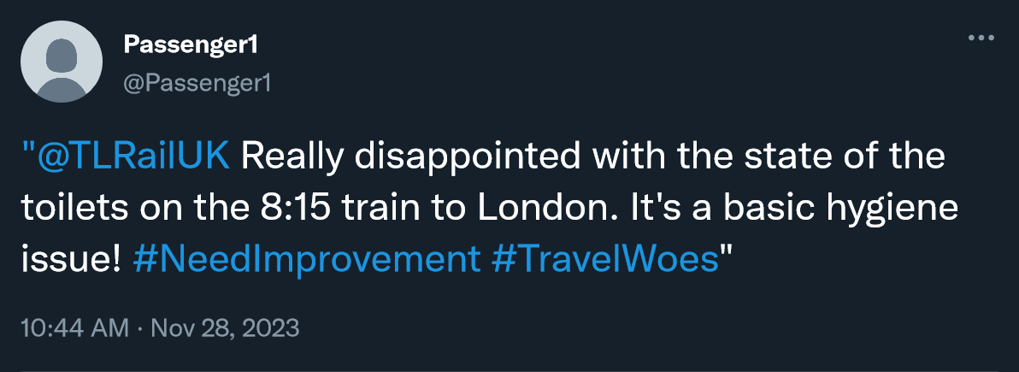
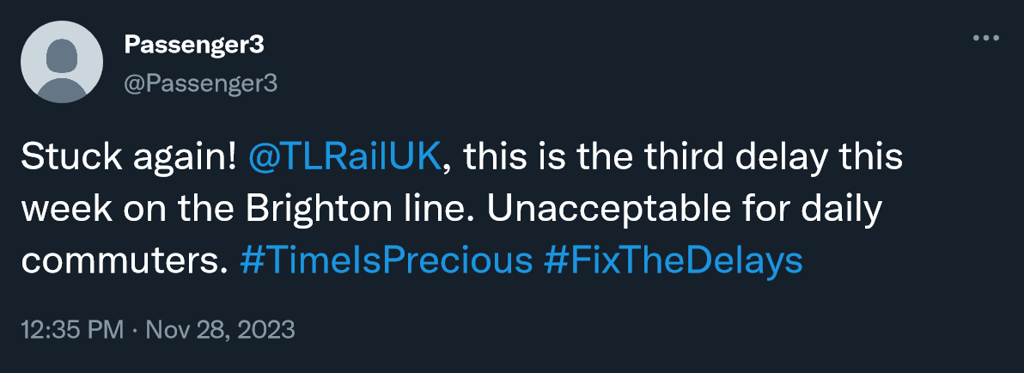
Model
Step 1. Pull tweets from X API
WHY?
Identify common issues
Trend analysis
Resource allocation

Slide 5
Model
Step 2. Analyse the Tweets
Tweets that originate from @TLRailUK.
The maintenance team is interested in understanding the customer’s issues, tweets from the service provider are not relevant for this purpose

Slide 6
Model
Step 2. Analyse the Tweets
Tweets that are about delays.
The maintenance team already tracks and analyses delays from operational data.
The team wants to focus on areas that can lead to direct action. Delays are generally caused by factors outside of the maintenance team’s control

Slide 7
Model
Step 2. Analyse the Tweets
Ironic Tweets
Ironic tweets often express negative sentiment through positive words, which can be misinterpreted by standard sentiment analysis algorithms.
Analyzing them separately ensures that their true sentiment is captured and understood.

Slide 8
Model
Step 2. Analyse the Tweets
Positive / Neutral Sentiment Tweets
The primary focus of the team is identifying areas needing improvement. Focusing on negative sentiment tweets provides more opportunities to do so.

Slide 9
Model
Step 2. Analyse the Tweets
Negative Sentiment Tweets
Negative feedback is directly indicative of problems experienced by customers. Focusing on such tweets helps in pinpointing specific issues that need to be addressed.

Slide 10
Model
Step 3. Ask GPT for Suggestions
Suggestion 1
GPT3.5
Suggestion 2
Suggestion 3

Slide 11
Model
Suggestion 1
GPT3.5
Suggestion 2
Suggestion 3

Slide 12
Model
Step 3. Ask GPT for Suggestions
Plan phased updates of train interiors, prioritizing high-traffic routes, to address both cleanliness and modernization.
Suggestion 1
Initiate immediate, thorough cleaning of trains, focusing on toilets and overall compartment cleanliness. Establish a regular inspection routine to maintain standards.
Suggestion 2

Slide 13
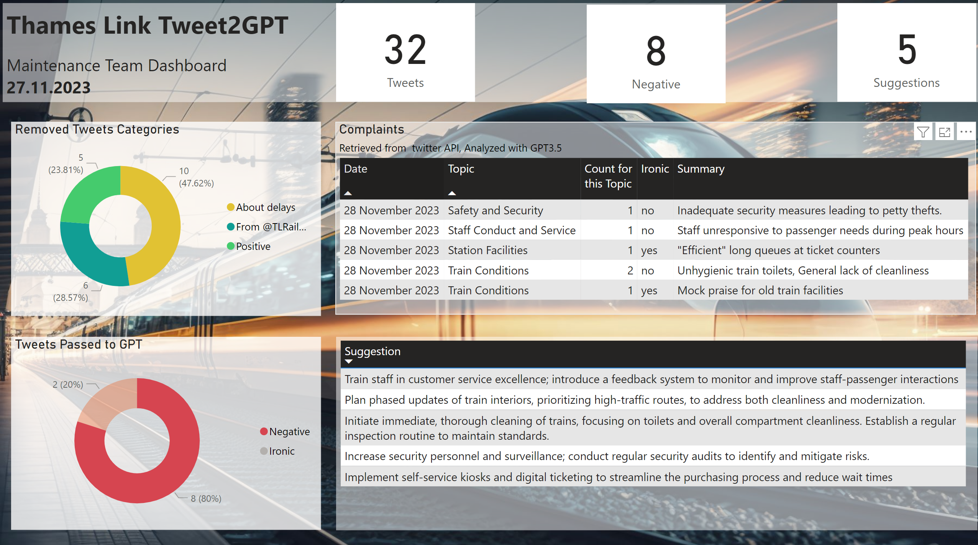
Tweets

